Slide 1
Architecture of the SureThing IT system
Bogdan DUMITRIU
Marjolijn ELSINGA
Sébastien RAVEAU
Reinier VIS

Slide 2
Agenda
Goals & quality attributes
Evolution of the system
Major changes
Minor changes
How quality attributes are achieved
Costs
Conclusion

Slide 3
Goals
Unified IT architecture
Website for customers and employees
24/7 availability
Real-time proposals calculation
Be able to cope with increase in customers
Access control

Slide 4
Desired quality attributes
Interoperability
Fault tolerance
Scalability
Security
Changeability
Response time

Slide 5
Current system (Zeker & Vast)
UCIS client
ProD
CHIPS
UCIS
STIFF
BuRP
Oracle
PROFI

Slide 6
Phase #1
ProD
UCIS
STIFF Wrapper
STIFF
Word documents
Oracle
Excel documents
Access documents

Slide 7
Phase #2
Website
UCIS client
GOC
CHIPS
UCIS
BuRP
PROFI

Slide 8
Phase #3
ProD
UCIS
STIFF Wrapper
STIFF
Oracle
PROFI

Slide 9
Phase #4
Testing
Fixing of possible faults
Performance evaluation
Possible hardware adjustments

Slide 10
Final system (SureThing)
Website
GOC
CHIPS
UCIS
STIFF
BuRP
Oracle
PROFI

Slide 11
Changes in UCIS
Centralization of the business logic
Reshape into a web application
Creation of an associated website for
  Call-Center employees
  Customers
  Partners

Slide 12
Changes in STIFF
Goals
  On-demand proposal calculations
  Scalability
Steps
  Wrapper (temporary solution)
  Full rewriting in Java for
    Functioning as a distributed system
    Integration with UCIS

Slide 13
Changes to the Oracle database
Design of a flexible structure for product data support
Migration of the product data from ProD to the Oracle database
Creation of stored procedures, to centralize the data access code
Addition of structures for access control

Slide 14
Minor changes
CHIPS
  updated to interact with new UCIS
BuRP
  updated to interact with new UCIS
PROFI
  added GOC support
  updated to use store procedures

Slide 15
Quality attributes (1)
Interoperability
  the system is fully usable throughout the evolution of the project
  interaction with existing components is ensured
Fault tolerance
  protection against software failures
  protection against hardware failures
  data backed up and stored at a different location
Scalability

Slide 16
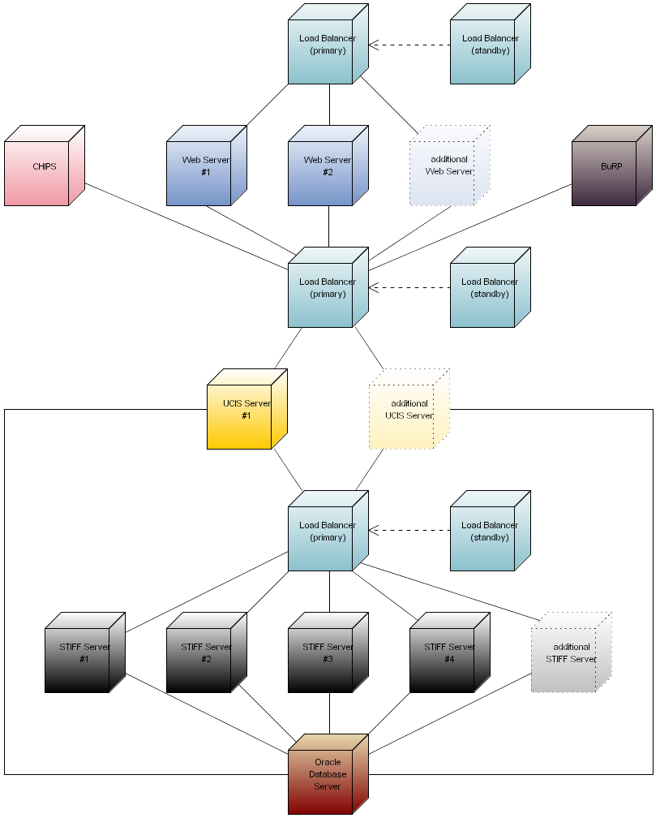

Slide 17
Quality attributes (2)
Security
  authentication & authorization on the website
  access control to the database
  network protection
Changeability
  modular design allows for easy updates

Slide 18
Quality attributes (3)
Response time
  STIFF now works on demand
  STIFF is now a distributed system
  optimal response time can be achieved by adjusting hardware resources
  all other resources fully scalable as well

Slide 19
Cost of the project
Ensured low costs by
  reusing as much as possible
  designing for scalability
  providing a portable solution, which
    can be now run on affordable hardware
    can use free software
    can be used ‘as-is’ on other platforms, that may become more advantageous in the future
Costs
  development: between €130,000 and €170,000
  hardware: up to €40,000

Slide 20
Why choose us?
All requirements addressed
All desired quality attributes fulfilled
Reasonably low investment at first
Highly profitable in the long term

